Slide 1

KubeEdge

Slide 2
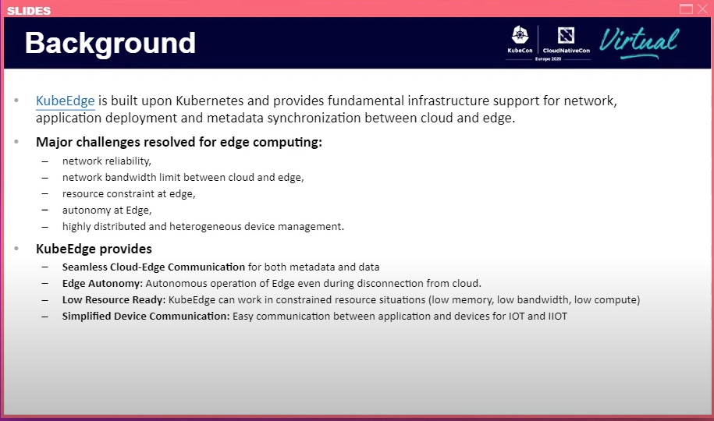
Cloud and edge are different

Slide 3
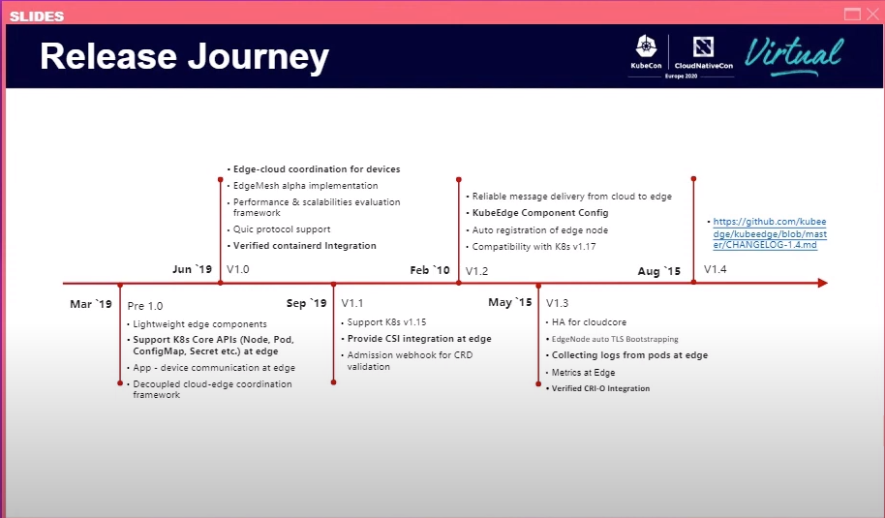

Slide 4
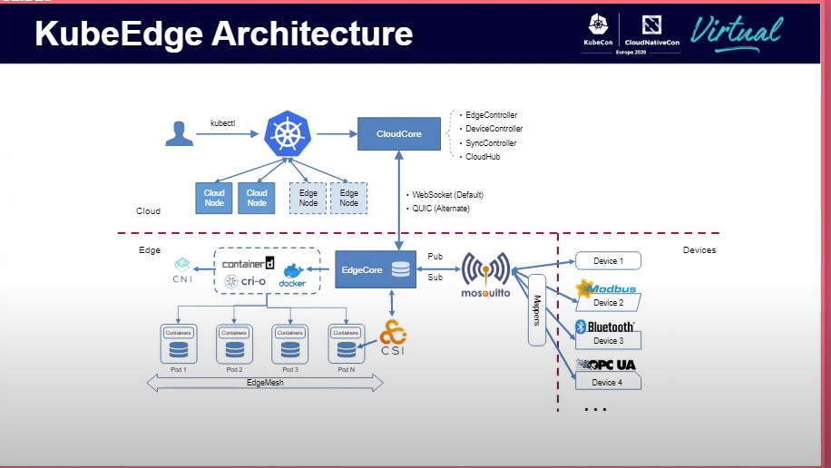

Slide 5
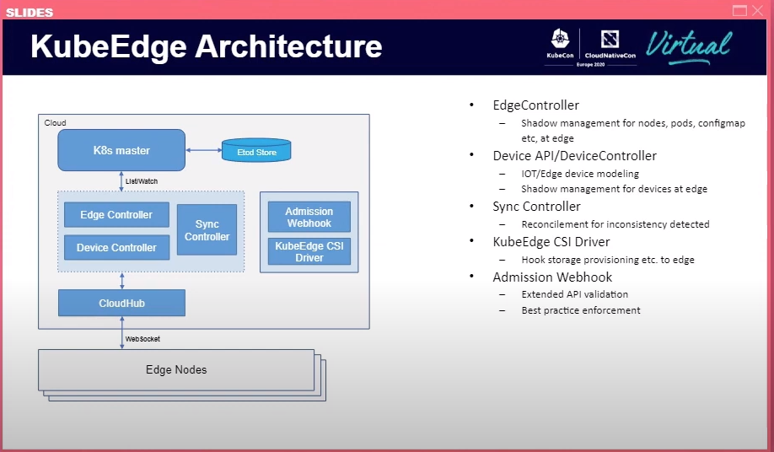

Slide 6
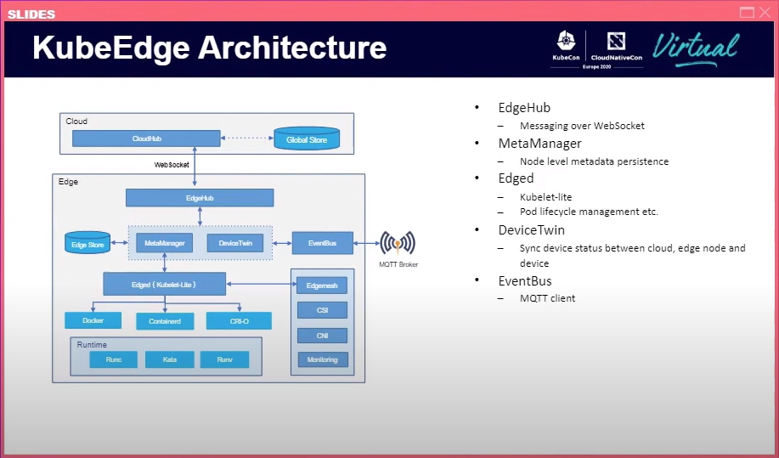

Slide 7
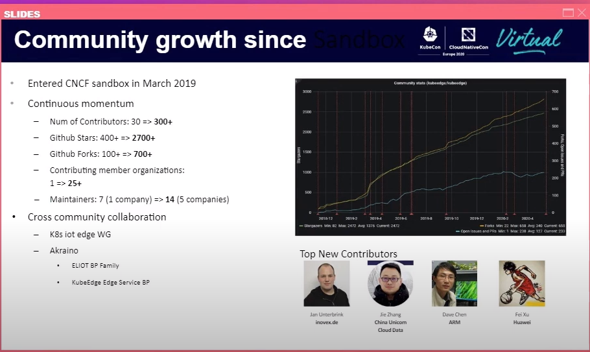

Slide 8
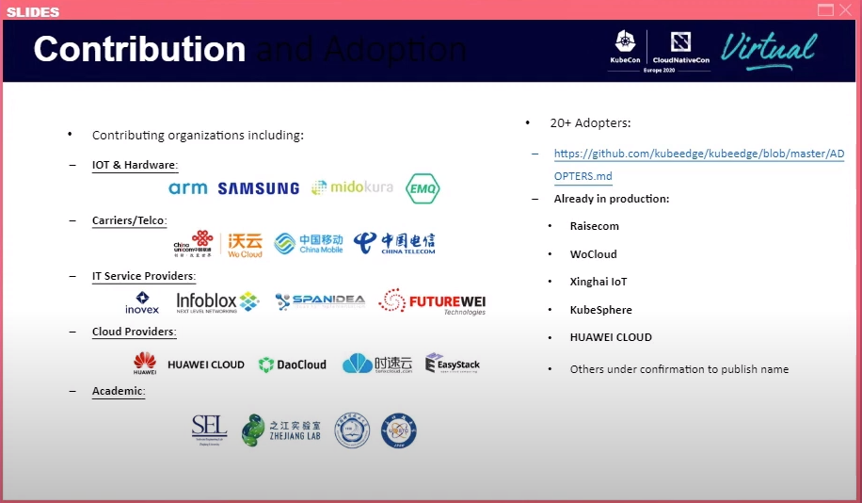

Slide 9
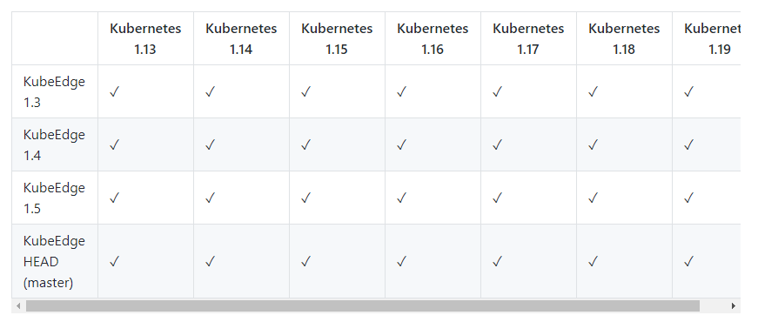
Kubernetes node
https://github.com/kubeedge/kubeedge#kubernetes-compatibility

Slide 10
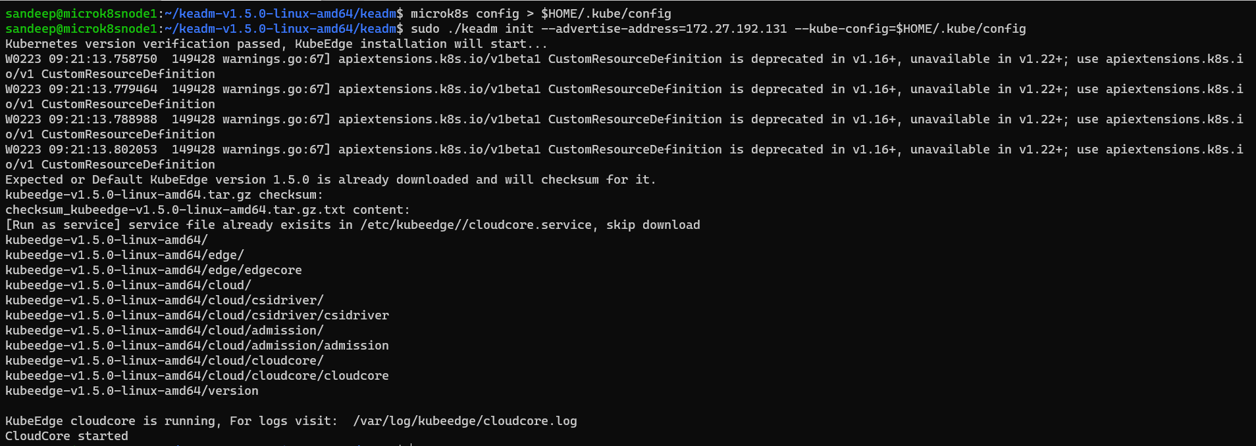
Install KUBEDGE IN Kubernetes Node
https://github.com/kubeedge/kubeedge/releases

Slide 11
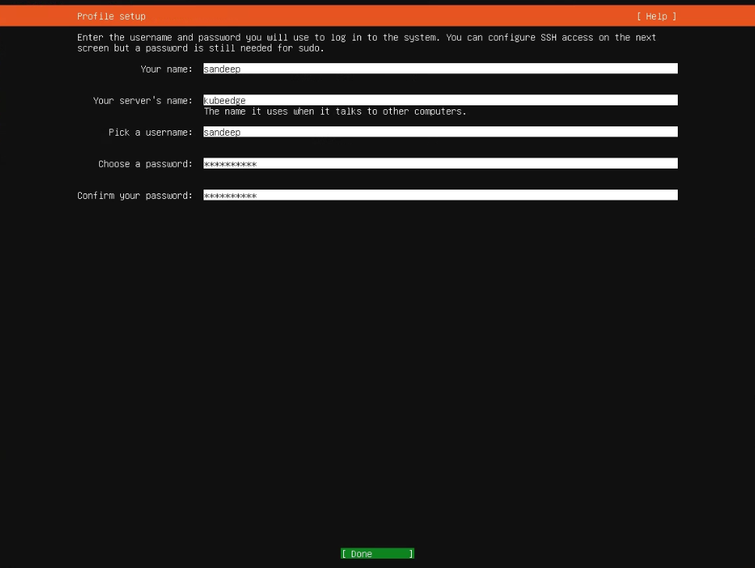
Edge Node

Slide 12
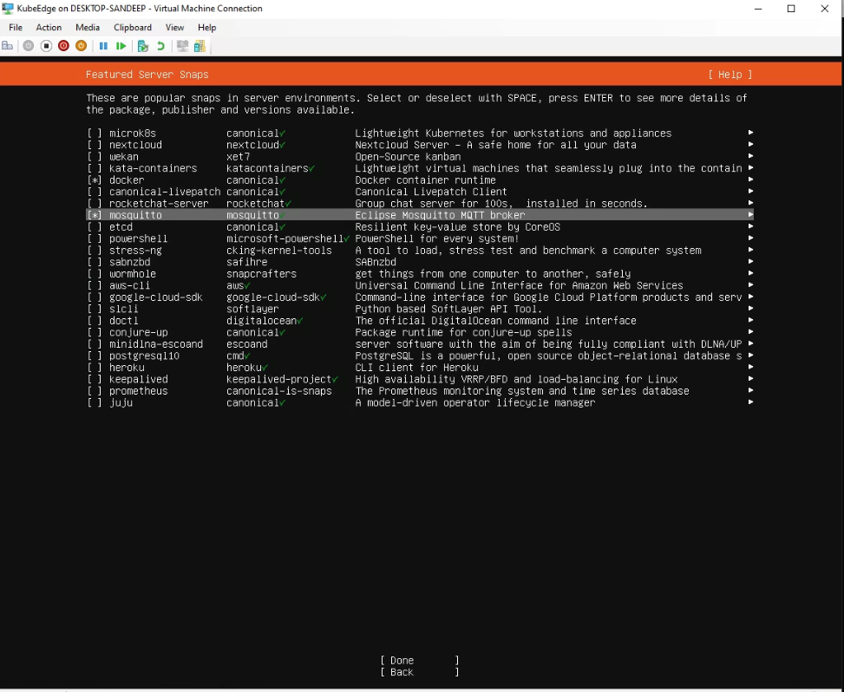

Slide 13

Assign static ip
sudo netplan apply

Slide 14
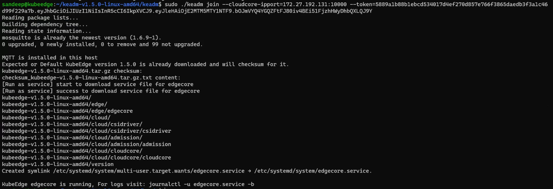

Slide 15


Slide 16
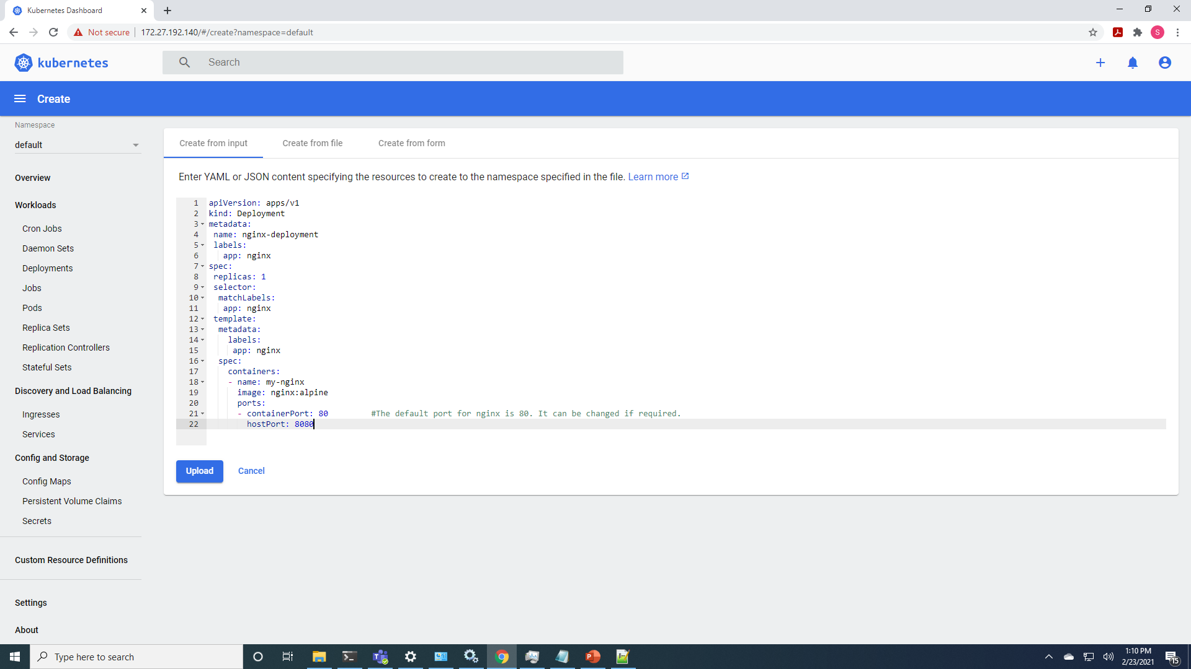

Slide 17
